Slide 1
Leadership with Cecilia
What it means and how to sharpen your skills

Slide 2
Who is a role model in your life?
What does leadership mean to you?

Slide 3
SERVE
S: Show respect
E: Earn Trust
R: Reach for perfection
V: Value Input
E: Energize others

Slide 4
Leadership: changing the order of things
A leader: a person who focuses on unlocking potential for others and leaving a legacy behind
A person who is extremely passionate about a certain thing that they take responsibility and initiative to bring about change
Story of Two Leaders:
Higher Lynn Type VS Owner Type

Slide 5
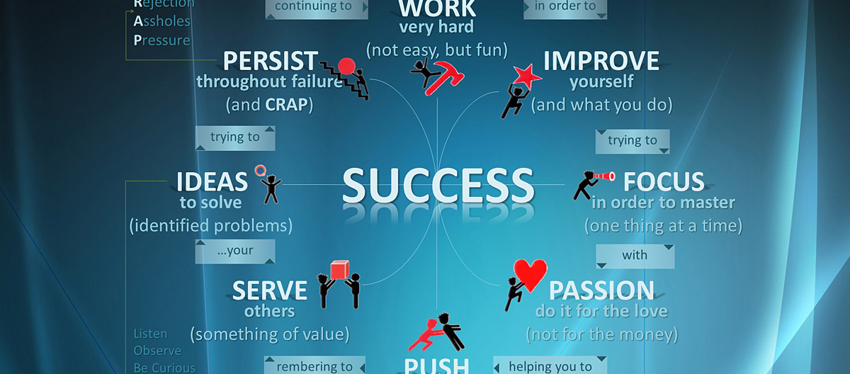
Leaders are MADE not BORN

Slide 6
What leadership looks like
Leadership is built on :
People who care about the grander vision
People who fuel their lives for something better
People who dedicate their lives into whatever they are passionate about

Slide 7
As a leader:
Model behaviour that you want others to adopt
Make sure your actions speak for themselves
Have faith in others, people can rise to the top with their potential, they CAN, they WILL, give them their CHANCE
You can’t get anywhere without the help of others
Understand that we are all equal, we are all gifted, no one is better than anyone else
Leadership is a choice, you can choose to dedicate yourself in helping others

Slide 8
Framework: Diagram
Vision
Culture
Organization
Metric/ Results

Slide 9
Tips to keep in mind
Take chances and go get messy, but it’s important to take responsibility for those mistakes
Your peers shape who you are and who you’re going to be/ where you want to go
Commitment-> Integrity & Change

Slide 10
Do not take NO for an answer
Make sure you are accountable, no excuses, own up to your mistakes
Connect with other people, and care for them
Grow other people’s self confidence
Start small, but start today
Make it so that people question your decisions instead of your intentions

Slide 11
Be careful!
Becoming a leader for the wrong reason
Failure to embrace vulnerability
Making leadership too important

Slide 12
A Big Thanks to
2014 Global Leadership Summit
Red Cross GI Symposium 2013
GIN Conference 2014
Shad Valley 2014
We Day

