Slide 1

A journey to self acceptance and love
Notes:
Share your bullying story :
Loss of self esteem -> how I felt
--story doesn’t end--- continue the story throughout the workshop

Slide 2
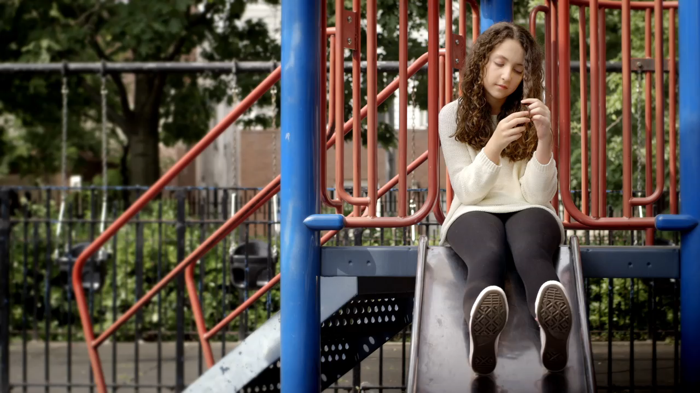
Notes:
After video: ask discussion questions

Slide 3

Notes:
Second discussion

Slide 4
Building self esteem in the world we live in today
Tips:
1. Finding your passion
2. Having a support group
3. Taking time to reflect on things we are thankful for and getting a better understanding of who we are (it is only through knowing what we are good at or are passionate at, that we can be able to celebrate those things)
4. Limiting social media exposure time (we all need a break sometimes)
Notes:
Appearances in social media
A lot of people don’t like themselves or how they appear
Caught up with appearances especially with social media and increasing technology
Finish the story about bullying
Talk about building self esteem

Slide 5
I PLEDGE
Write down one thing you will start doing, or doing differently, to champion what is real in yourself as a result of today’s workshop
Celebrate your individuality and the diversity of the people you know. Aim to be the best you can be because you are one of a kind.

Slide 6
Polaroid time
Notes:
Get the girls to take a picture (w/ or w/o their pledge) and get them to write one positive and powerful word they identify themselves with

